Slide 1
Open Tracing with Istio & OKE
London, 9 September 2019, Andrei Cioaca

Slide 2


About Me
ANDREI CIOACA
Lead Cloud Solutions Architect @ Capgemini UK
andrei.cioaca@capgemini.com
https://www.linkedin.com/in/andrei-cioaca-89b0a97b/
@andreicioaca
https://andreicioaca.com

Slide 3
Agenda
Why micro-services architecture?
Container Engine for Kubernetes overview
Microservice Observability?
Observability pillars
Istio introduction
How to setup Istio on OKE
Jaeger and Kiali
How open tracing works - Scenario
Questions

Slide 4
What are Microservices?
Microservices are small, autonomous services that work together.
Small and focused on doing one thing well
Focus the service boundaries on business boundaries
Code lives for a given piece of functionality
The smaller the service -> the more you maximize the benefits and downsides of microservice architecture
Autonomous
A microservice is a separate entity
Deployed in isolation on a PaaS or on its own operating system process.
All communication between microservices are through APIs.

Slide 5
Key Benefits of Microservices
Technology Heterogeneity – microservices allow to easily embrace different technologies
Resilience – if one component fails and it’s doesn't cascade – isolate the problem and the rest of the system will carry on
Scaling – you can target scaling at just those microservices that need it
Ease of deployment – you can make change to a single service and deploy it independently
Organizational alignment – minimize team size and increase productivity
Composability – as circumstances change, we can build things in different ways
Optimizing for Replaceability - low cost of replace or delete, much easier to change
The Microservices architecture has many appealing qualities, but the road towards it has painful traps for the unwary.

Slide 6
Microservices Tips
Discover how microservices allow you to align your system design with your organization’s goals
Learn options for integrating a service with the rest of your system
Take an incremental approach when splitting monolithic codebases
Examine the complexities of testing and monitoring distributed services
Manage security with user-to-service and service-to-service models
Deploy individual microservices through continuous integration
Understand the challenges of scaling microservice architectures

Slide 7
OKE
Oracle Cloud Infrastructure Container Engine for Kubernetes is a fully-managed, scalable, and highly available service that you can use to deploy your containerized applications to the cloud.
Access through Oracle Cloud Console / CLI / Rest APIs
All OKEs have assigned a unique identifier, Oracle Cloud ID (OCID)
Limitations – each cluster can have a maximum of 1000 nodes
In order to use OKE you must be given the required type of access in a policy written by an administrator
RBAC support
Full bare metal performance

Slide 8
What is Observability?
Similar to blockchain, serverless, AI and ML and service meshes, Observability is a hot buzz word in the IT industry right now.
Observability is a measure of how well internal states of a system can be inferred from knowledge of its external outputs.
As modern distributed systems grow ever more complex, the ability to observe those systems demands equally modern tooling that was designed with this level of complexity in mind.
Traditional logging and monitoring systems often struggle with today’s hybrid and multi-cloud, polyglot language-based, event-driven, container-based and serverless, infinitely-scalable, ephemeral-compute platforms.
Logs, metrics, and traces are often known as the three pillars of observability.

Slide 9
Pillar 1: Logging
An event log is an immutable, timestamped record of discrete events that happened over time.
Event logs in general come in three forms but are fundamentally the same: a timestamp and a payload of some context.

Slide 10
Event Logs Forms
Plaintext
Structured
Binary
A log record might be free-form text.
The most common format of logs.
Much evangelized and advocated for in recent days.
Typically, these logs are emitted in the JSON format.
Think logs in the Protobuf format, MySQL binlogs used for replication and point-in-time recovery, systemd journal logs, the pflogformat used by the BSD firewall pf that often serves as a frontend to tcpdump.

Slide 11
The Pros and Cons of Logs
PROS
CONS
Logs are, by far, the easiest to generate. The fact that a log is just a string or a blob of JSON or typed key-value pairs makes it easy to represent any data in the form of a log line.
Most languages, application frameworks, and libraries come with support for logging.
Logs are also easy to instrument, since adding a log line is as trivial as adding a print statement.
Logs perform really well in terms of surfacing highly granular information pregnant with rich local context, so long as the search space is localized to events that occurred in a single service.
The utility of logs, unfortunately, ends right there. While log generation might be easy, the performance idiosyncrasies of various popular logging libraries leave a lot to be desired.
Most performant logging libraries allocate very little, if any, and are extremely fast. However, the default logging libraries of many languages and frameworks are not the cream of the crop, which means the application as a whole becomes susceptible to suboptimal performance due to the overhead of logging.
Additionally, log messages can also be lost unless one uses a protocol like RELP to guarantee reliable delivery of messages. This becomes especially important when log data is used for billing or payment purposes.

Slide 12
Pillar 2: Metrics
Metrics are a numeric representation of data measured over intervals of time.
Metrics can harness the power of mathematical modelling and prediction to derive knowledge of the behaviour of a system over intervals of time in the present and future.
Since numbers are optimized for storage, processing, compression, and retrieval, metrics enable longer retention of data as well as easier querying.
Perfectly suited to building dashboards that reflect historical trends.
Allow for gradual reduction of data resolution.
After a certain period of time, data can be aggregated into daily or weekly frequency.

Slide 13
The Anatomy of a Modern Metric
One of the biggest drawbacks of historical time-series databases has been the identification of metrics that didn’t lend itself very well to exploratory analysis or filtering.
The hierarchical metric model and the lack of tags or labels in older versions of Graphite especially hurt.
Modern monitoring systems like Prometheus and newer versions of Graphite represent every time series using a metric name as well as additional key-value pairs called labels. This allows for a high degree of dimensionality in the data model.
A metric in Prometheus, is identified using both the metric name and the labels. The actual data stored in the time series is called a sample, and it consists of two components: a float64 value and a millisecond precision timestamp.

Slide 14
Advantages of Metrics over Event Logs
Metrics transfer and storage has a constant overhead.
Metrics doesn’t increase in lockstep with user traffic or any other system activity that could result in a sharp uptick in data.
With metrics, an increase in traffic to an application will not incur a significant increase in disk utilization, processing complexity, speed of visualization, and operational costs.
Metrics storage increases with more permutations of label values (e.g., when more hosts or containers are spun up, or when new services get added or when existing services get instrumented more), but client-side aggregation can ensure that metric traffic doesn’t increase proportionally with user traffic.
Metrics, once collected, are more malleable to mathematical, probabilistic, and statistical transformations such as sampling, aggregation, summarization, and correlation.
Metrics are also better suited to trigger alerts, since running queries against an in-memory, time-series database is far more efficient.

Slide 15
The Drawbacks of Metrics
The biggest drawback with both application logs and application metrics is that they are system scoped, making it hard to understand anything else other than what’s happening inside a particular system. Sure, metrics can also be request scoped, but that entails a concomitant increase in label fan-out, which results in an increase in metric storage.

Slide 16
Pillar 3: Traces
A trace is a representation of a series of causally related distributed events that encode the end-to-end request flow through a distributed system.
Traces are a representation of logs; the data structure of traces looks almost like that of an event log. A single trace can provide visibility into both the path traversed by a request as well as the structure of a request.
Although discussions about tracing tend to pivot around its utility in a microservices environment, it’s fair to suggest that any sufficiently complex application that interacts with—or rather, contends for—resources such as the network, disk, or a mutex in a nontrivial manner can benefit from the advantages tracing provides.
Traces are used to identify the amount of work done at each layer while preserving causality by using happens-before semantics.

Slide 17
The Challenges of Tracing
Tracing is, by far, the hardest to retrofit into an existing infrastructure, because for tracing to be truly effective, every component in the path of a request needs to be modified to propagate tracing information.
The second problem with tracing instrumentation is that it’s not sufficient for developers to instrument their code alone. A large number of applications in the wild are built using open source frameworks or libraries that might require additional instrumentation.
The cost of tracing isn’t quite as catastrophic as that of logging, mainly because traces are almost always sampled heavily to reduce runtime overhead as well as storage costs.

Slide 18
Service Meshes: A New Hope for the Future?
While tracing has been difficult to implement, the rise of service meshes make integrating tracing functionality almost effortless.

Slide 19

When building microservice based application, a myriad of complexities arises, we need Service Discovery, Load balancing, Application resilience, Optimization of hardware utilization to name just a few.
And as the application grows it gets progressively worse.
Kubernetes providing a solution to these complexities was immediately well received and reached a wide adoption in all cloud computing service providers.
This simplification of Orchestrating Microservices enables teams to easily get to ten and then even more services, which causes a different set of problems, for example:
Traffic management: Timeouts, retries, canary rollouts,
Security: End-user Authentication and Authorization,
Observability: Tracing, monitoring, and logging.
All of these can be solved and implemented in the application layer.
Istio is an Open Source project that solves all the above-mentioned problems

Slide 20
The Idea of Istio
Istio provides an ingenious solution to all the mentioned requirements. The gist of Istio is to be completely separated from the services and act only by intercepting all network communication.
And it turns out that by intercepting network communication it can implement:
Fault Tolerance – Using response status codes know when a request failed and retry.
Canary Rollouts – Forward only the specified percentage of requests to a service.
Monitoring and Metrics – The time it took for a service to respond.
Tracing and Observability – It adds special headers in every request and traces them in the cluster.
Security – Extracts the JWT Token and Authenticates and Authorizes users.

Slide 21
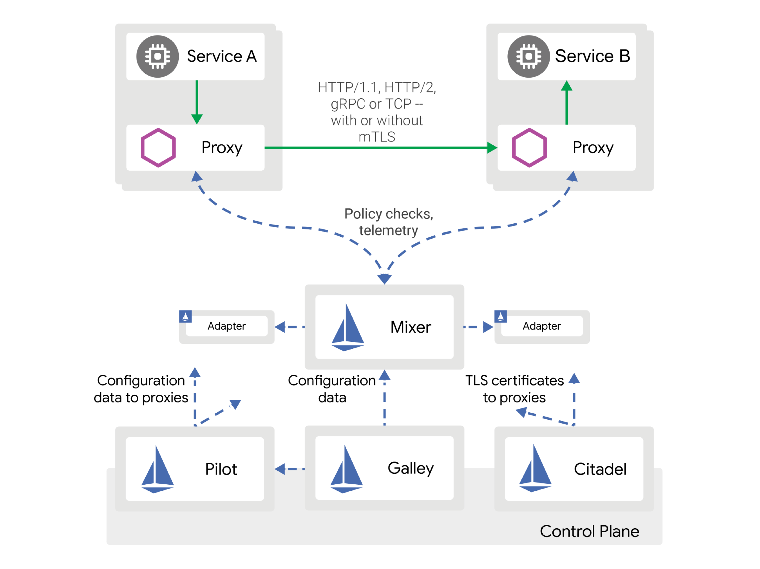
Istio’s Architecture
Istio needs to intercept all the network communication to and from every service and apply a set of rules. This is achieved and logically split into two planes: The Data Plane and The Control Plane.
Istio Architecture – Source: https://istio.io

Slide 22
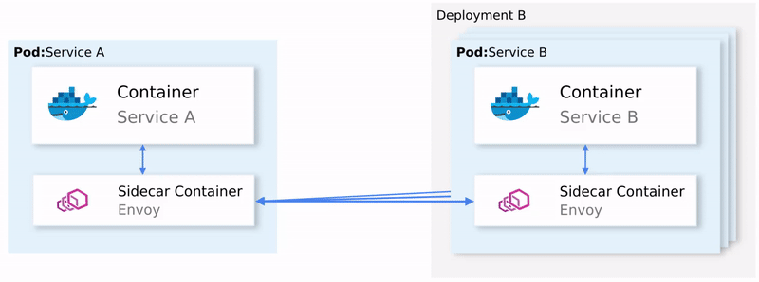
The Data Plane
To intercept all the network communication Istio injects an intelligent Envoy proxy as a sidecar in every pod.
The injected proxies represent the data plane.
Using those proxies Istio easily can achieve our requirements, for an example let’s check out the retrying and Circuit breaking functionalities.
Notes:
To summarize:
Envoy sends a request to the first instance of service B and it fails.
The Envoy Sidecar retries. (1)
Returns a failed request to the calling proxy.
Which opens the Circuit Breaker and calls the next Service on subsequent requests. (2)

Slide 23
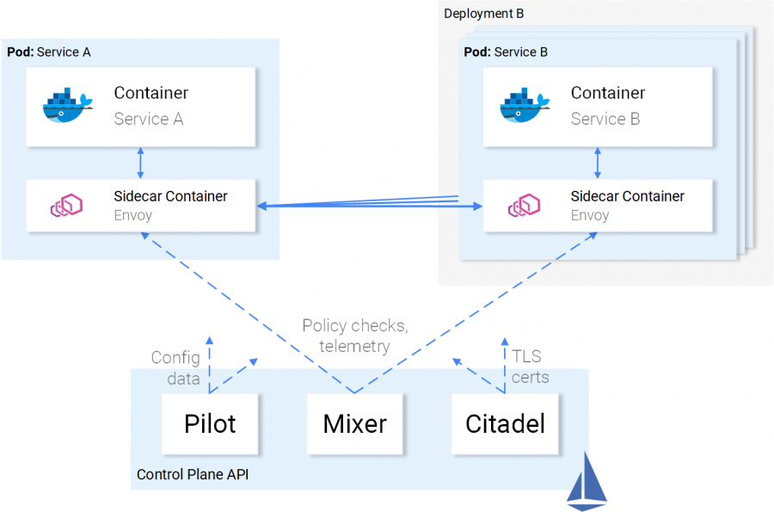
The Control Plane
Is composed of three components: The Pilot, the Mixer, and the Citadel that in combination configure Envoys to route traffic, enforce policies and collect telemetry data.

Slide 24
Istio Setup on OKE – based on Helm
1
Grant the Kubernetes RBAC cluster-admin clusterrole to a OCI user based on the user’s Oracle Cloud Identifier (OCID).
2
Download Istio’s latest release
3
Helm and Tiller installation
4
Create istio-system namespace and secret for Kiali

Slide 25
5
Install the istio-init Helm chart to bootstrap all the Istio’s Custom Resource Definitions (CRDs)
helm install $ISTIO_HOME/install/kubernetes/helm/istio-init --name istio-init --namespace istio-system \ --set certmanager.enabled=true

Slide 26
6
Install Istio with Helm the desired confirmation profile.
helm install $ISTIO_HOME/install/kubernetes/helm/istio
--name istio
--namespace istio-system \
--set sds.enabled=true \
--set gateways.istio-ingressgateway.sds.enabled=true \
--set pilot.traceSampling=100.0 \
--set pilot.resources.requests.cpu=1800m \
--set telemetry-gateway.grafanaEnabled=true \
--set telemetry-gateway.prometheusEnabled=true \
--set grafana.enabled=true \
--set tracing.enabled=true \
--set tracing.jaeger.ingress.enabled=true \
--set kiali.enabled=true \
--set kiali.dashboard.jaegerURL='http://localhost:16686’ \
--set kiali.dashboard.grafanaURL='http://grafana.istio-system:3000'
Notes:
Install Istio with Secret Discovery Service (SDS) to enable a few additional configurations for the gateway TLS. This will allow you to: Dynamically update the gateway TLS with multiple TLS certificates to terminate TLS connections.

Slide 27

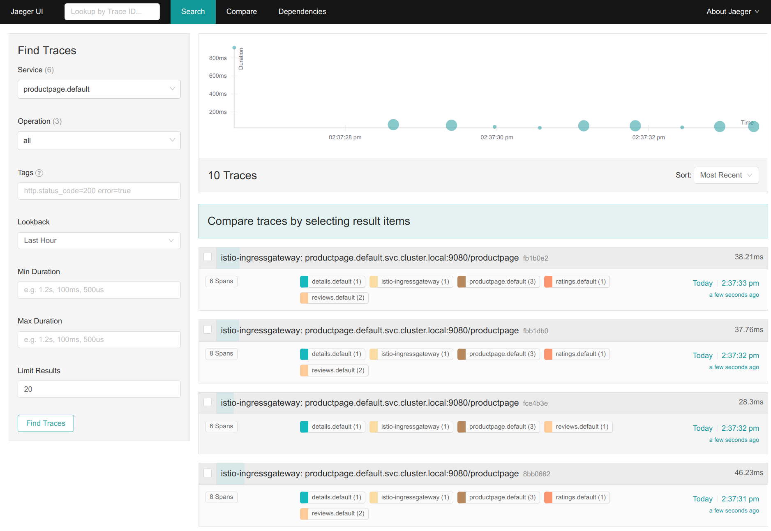
Jaeger

Slide 28
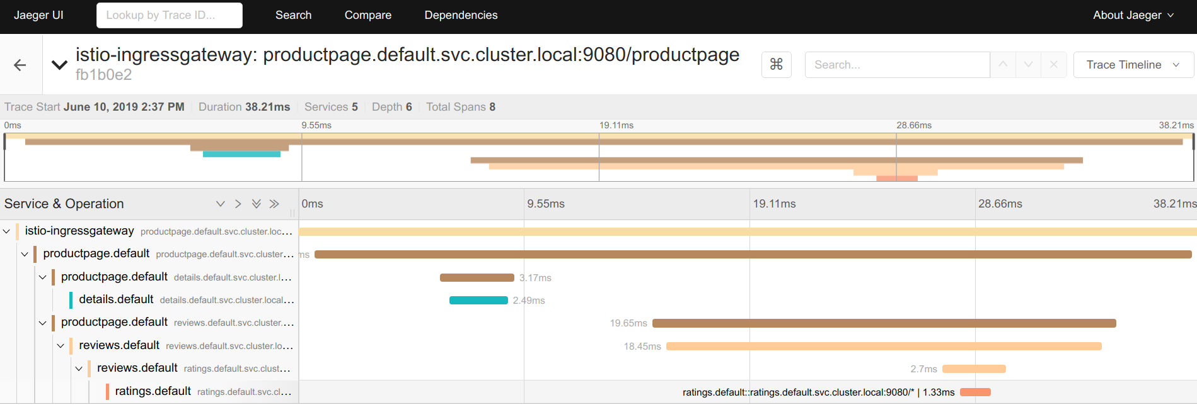

Slide 29

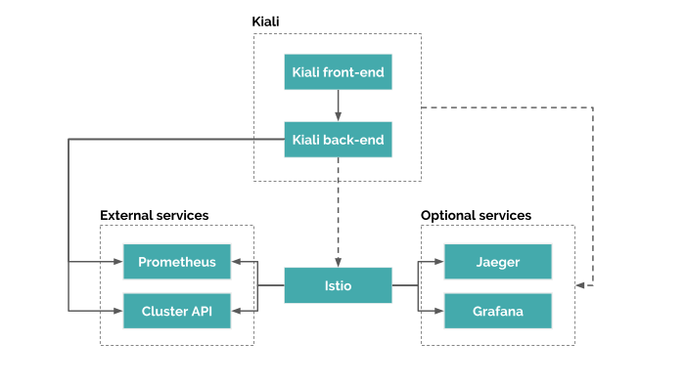

Slide 30
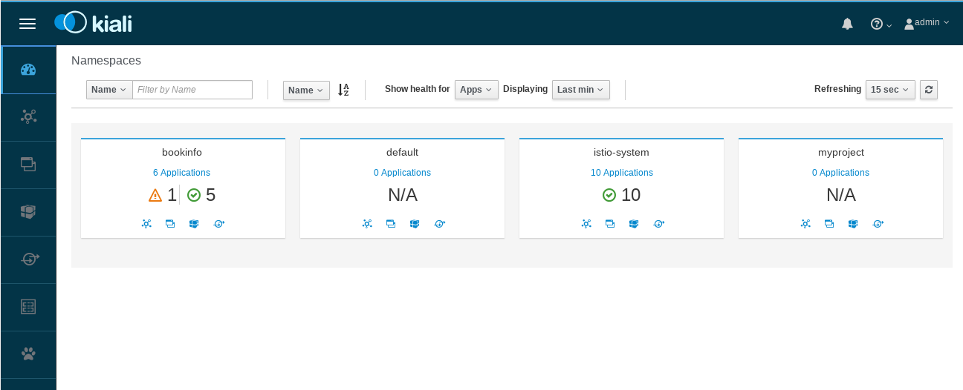

Slide 31
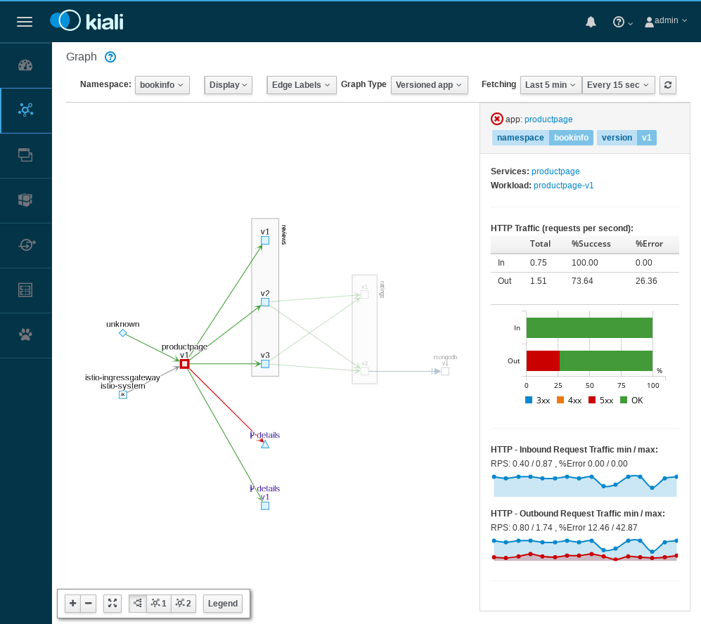

Slide 32
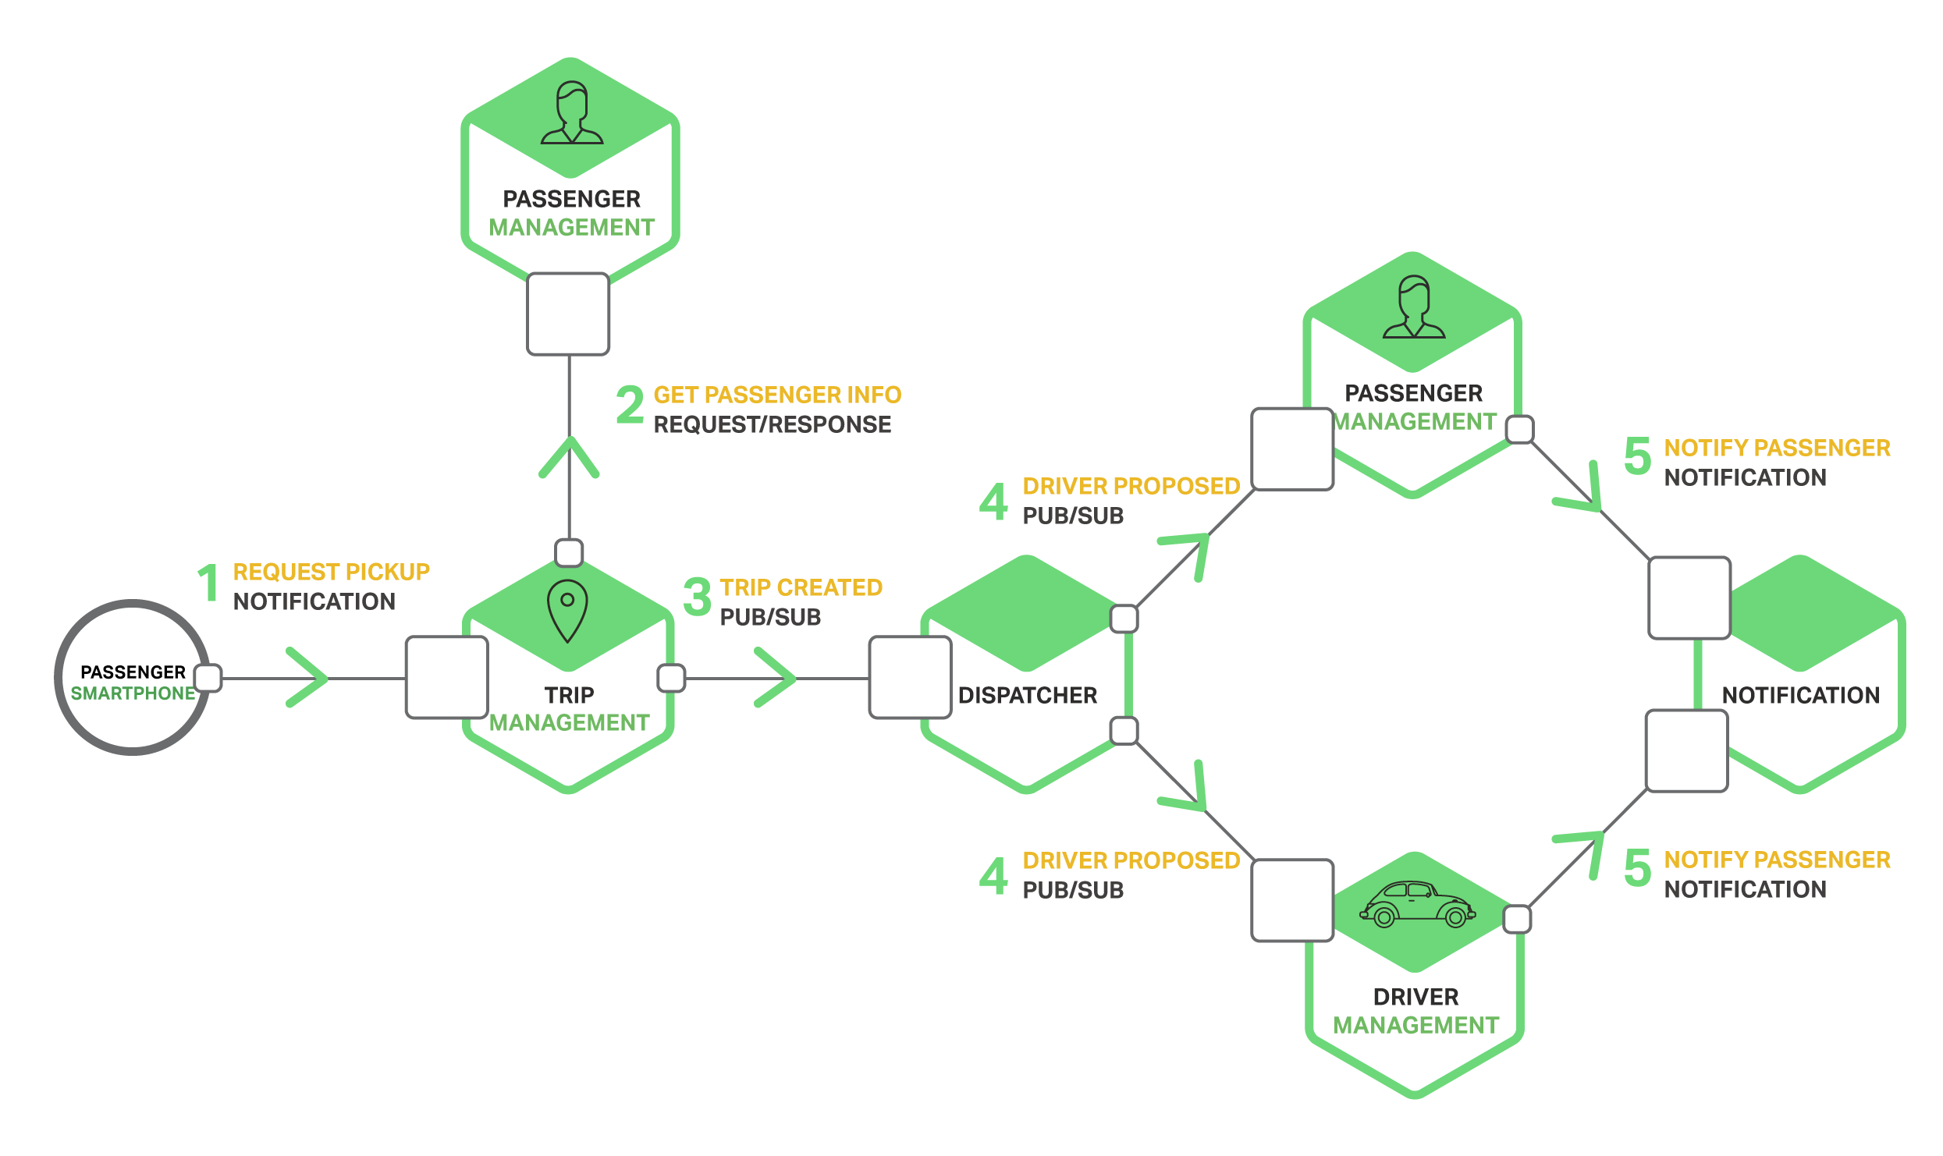
Architecture overview scenario
Notes:
Talk about this scenario and how will be the this traced with Istio.

Slide 33


